Slide 1
Time Series: 6373
Unit 1: Conditions of Stationary and Basic Estimation

Slide 2
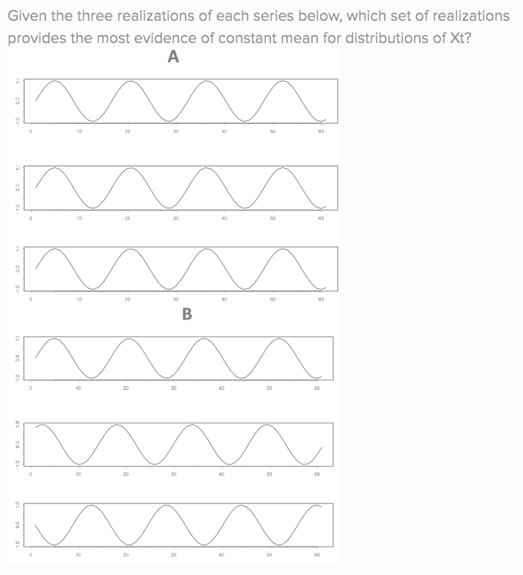
Review of Question 1.5.4

Slide 3
Break Out #1
Each of the next few slides have a plot of a time series and a description on them. Spend a few minutes reading and thinking about each one and then answer the following questions for each series:
Is the series stationary? If not, which of the 3 conditions is/are violated?
Is it practical / possible to obtain another realization? Are there any assumptions you would have to make to consider multiple realizations.

Slide 4
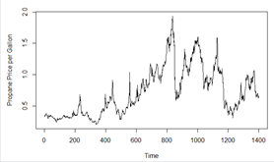
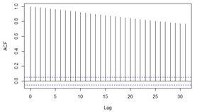
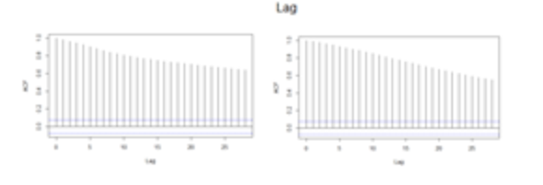
WEEKLY PROPANE PRICE PER GALLON
Description: This is a time series data set of the number of weekly Mont Belviue, TX propane prices per gallon from July 1992 to April 2019. The data is publicly available at the U.S. Energy Information Administration (EIA) website.

Slide 5
WEEKLY PROPANE PRICE PER GALLON
Description: This is a time series data set of the number of weekly Mont Belviue, TX propane prices per gallon from July 1992 to April 2019. The data is publicly available at the U.S. Energy Information Administration (EIA) website.
Condition 1: Constant mean seems plausible here given the realization. On the other hand there may be an argument to be made that more propane may be used in the winter in Mont Belviue, Texas. The other idea is that if we generate realizations from a stationary time series model with a phi close to 1, we can easily generate a realization that looks like this.
Condition 2: There does seem to be some evidence of non constant variance as there seems to be tendency to make huge jumps. It is tough since we have only one realization and a limited domain knowledge of propane prices.
Condition 3: Judging from the ACFs, the covariance seems to not depend on where in the series we are, only how far apart the observations are.
Realization: Given that there are more people and more draw on the propane infrastructure, it would be impossible to obtain another realizations.

Slide 6
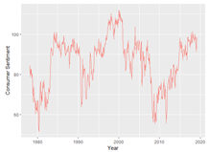

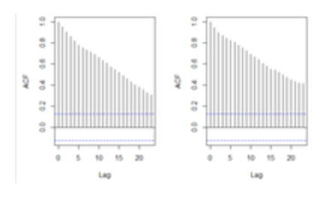
Monthly Consumer Sentiment 1978-2019
Description: This is a time series data set of consumer sentiment measured by the study from the University of Michigan: Consumer Sentiment [UMCSENT], retrieved from FRED, Federal Reserve Bank of St. Louis; https://fred.stlouisfed.org/series/UMCSENT, May 6, 2019.

Slide 7
Monthly Consumer Sentiment 1978-2019
Description: This is a time series data set of consumer sentiment measured by the study from the University of Michigan: Consumer Sentiment [UMCSENT], retrieved from FRED, Federal Reserve Bank of St. Louis; https://fred.stlouisfed.org/series/UMCSENT, May 6, 2019.
Condition 1: Just judging from the series and not knowing much about consumer sentiment it is reasonable to believe that the mean consumer sentiment is not dependent on time. That is, if we were able to observe another realization of this series, we might be just as likely to observe troughs were there are peaks and peaks where there are troughs as any other outcome.
Condition 2: There is not a lot of evidence against constant (and finite) variance. Again we have to imagine how other realizations would behave.
Condition 3: Judging from the ACFs, there is little to no evidence that the covariance is different from the first half of the series to the second.
Realization: This is the only realization we could view as is it unlikely that “Consumer Sentiment” existed before 1978.

Slide 8
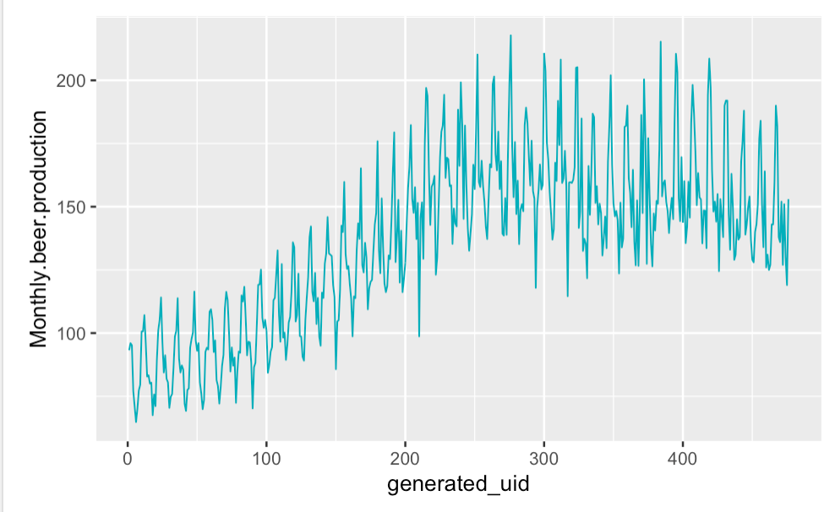
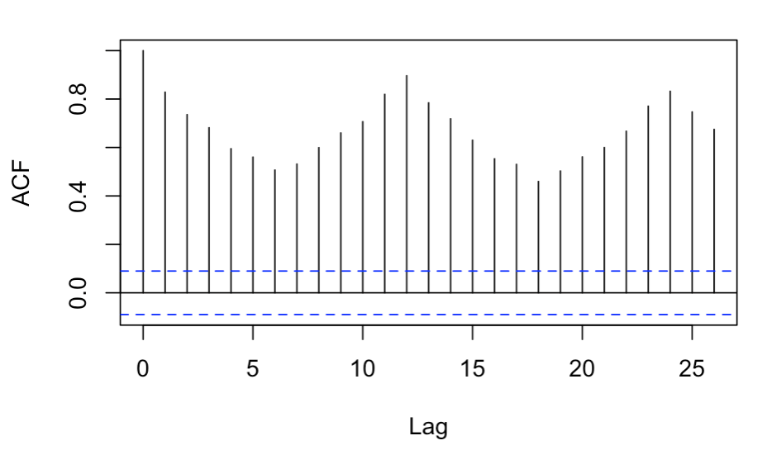
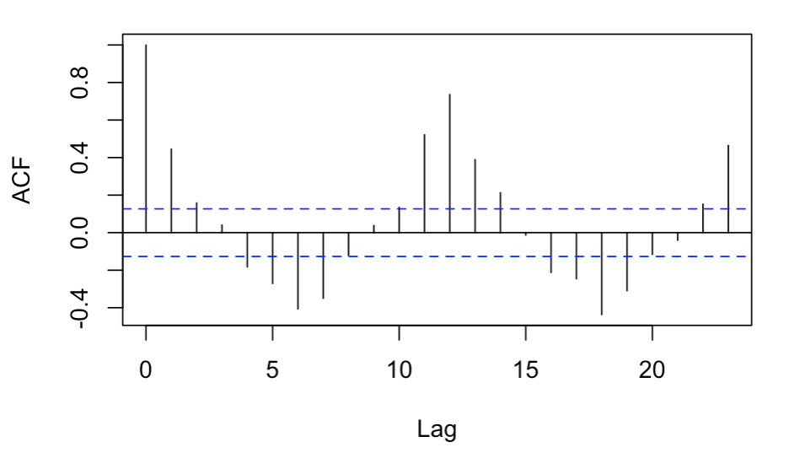
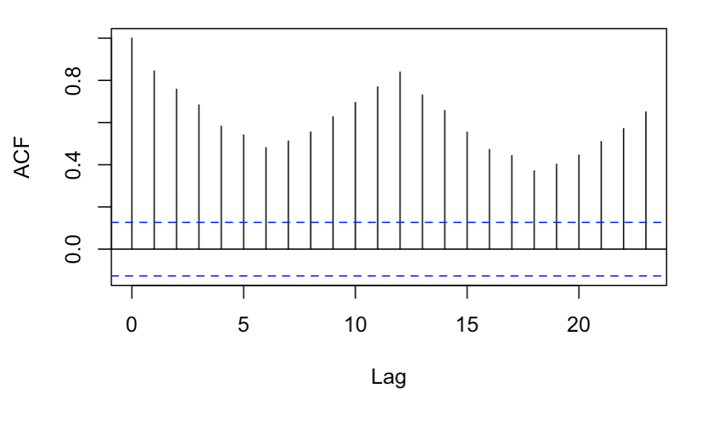
Beer Produced Monthly in Australia 1956-1995 (in megalitres)
Description: This is a time series data set of the amount of megalitres of beer produced in Australia from January 1956 to August 1995. The data is publicly available at https://www.kaggle.com/shenba/time-series-datasets#monthly-beer-production-in-austr.csv

Slide 9
Beer Produced Monthly in Australia 1956-1995 (in megalitres)
Description: This is a time series data set of the amount of megalitres of beer produced in Australia from January 1956 to August 1995. The data is publicly available at https://www.kaggle.com/shenba/time-series-datasets#monthly-beer-production-in-austr.csv
Condition 1: Looks like there is at least one frequency in the series and that there may be some wandering behavior as well. We may need to know more about the beer industry here but it is likely that beer is constantly produced to keep up with demand which is probably seasonal. If this is the case then the mean beer production would be conditional on the month and thus not stationary.
Condition 2: Again, this may take a little domain knowledge as it is quite possibly that the variance in production is increasing or at least changing over time. This could be because of the addition of breweries or a shifting in tourist populations / numbers(as an example.)
Condition 3: Judging from the ACFs, there is strong evidence that the covariance structure is dependent on where we are in the series.
Realization: While there is no way to turn back the clock and see another series, it is also unlikely that looking at a different 40 year span will be comparable to this particular series.

Slide 10
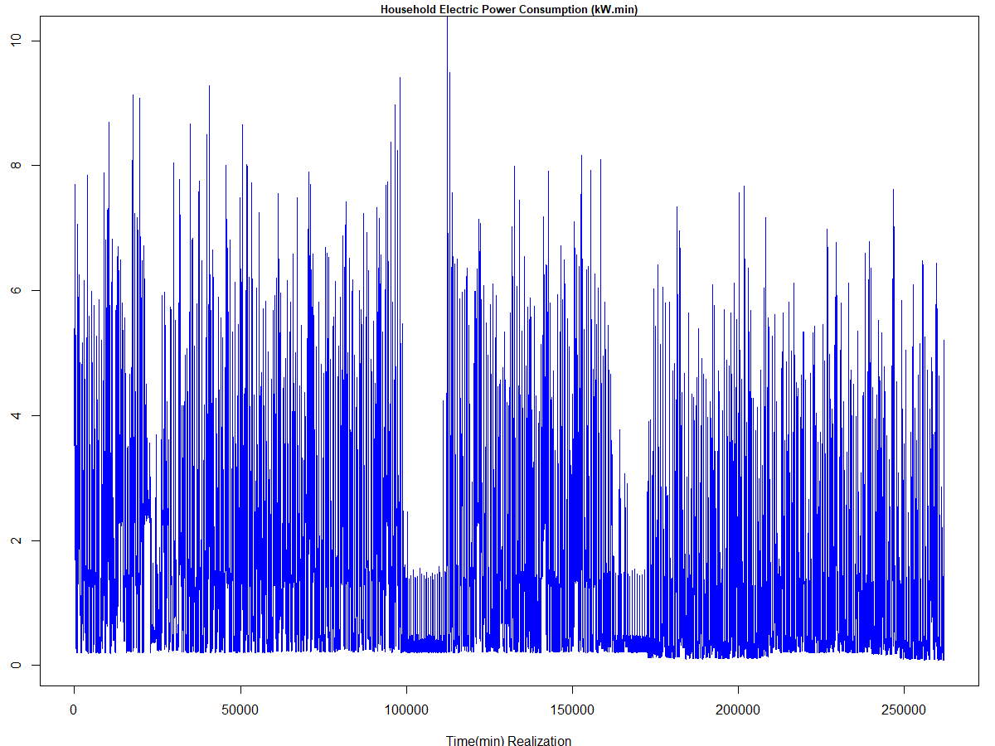
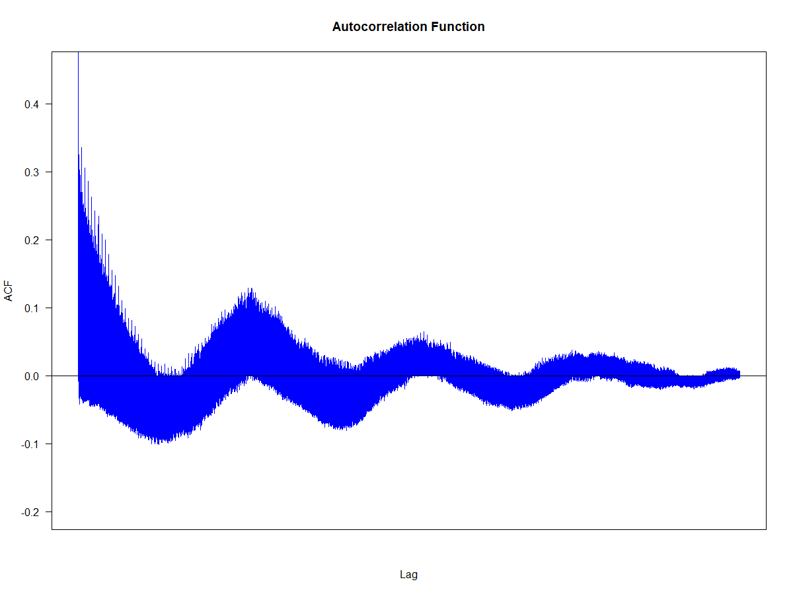
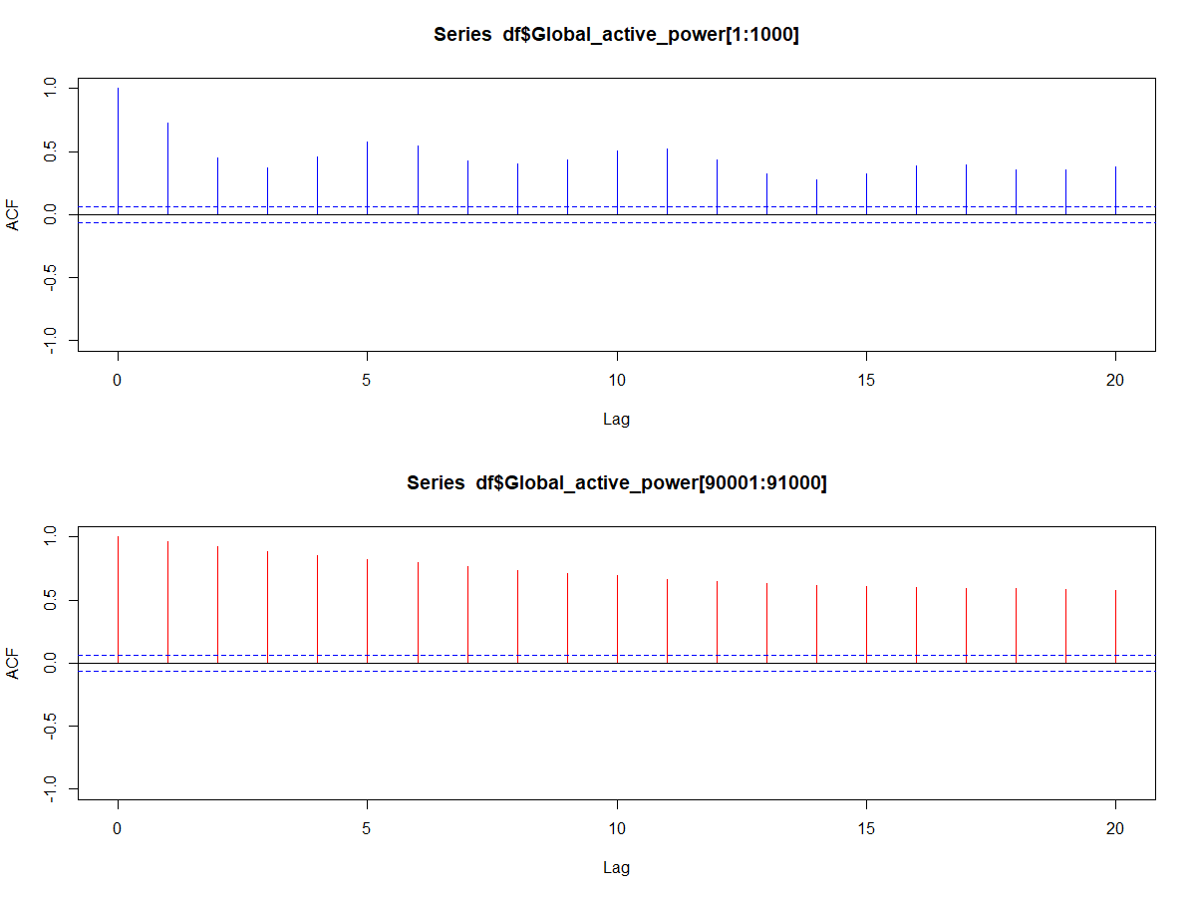
HOUSEHOLD ELECTRIC ENERGY CONSUMPTION (kW.min)
Description: This is a time series data set of electric power consumption for a household with one minute sampling rate from December 2006 to November 2010. The data is publicly available at UCI Machine Learning Repository https://archive.ics.uci.edu/ml/datasets/Individual+household+electric+power+consumption. Note: Although dataset includes 47 months of observations, for clarity, the graphic (Top) only displays 6 months.

Slide 11
HOUSEHOLD ELECTRIC ENERGY CONSUMPTION (kW.min)
Description: This is a time series data set of electric power consumption for a household with one minute sampling rate from December 2006 to November 2010. The data is publicly available at UCI Machine Learning Repository https://archive.ics.uci.edu/ml/datasets/Individual+household+electric+power+consumption. Note: Although dataset includes 47 months of observations, for clarity, the graphic (Top) only displays 6 months.
Condition 1: The mean is likely not constant over time as different times of the day as the usage will depend on the time of the day (temperature / occupancy / etc.). In addition.
Condition 2: If we assume that there will always be vacations, then variance will always be smaller during those periods. Therefore, if we assume that vacations are more likely to happen in the Summer or around Christmas, then variance will not be constant over time (although it will be finite). We should consider treating the vacation part of the series differently (modelling it differently).
Condition 3: Judging from the ACFs, I don’t see a lot of evidence against equal covariance structure across time.
Realization: This always takes some thinking, but it is conceivable that a different years’s 6 months could serve as a reliable / realistic additional realization although again, we need to assume that the conditions are similar the realization that we have (One isn’t in a time of war, or different solar conditions, etc.)

Slide 12
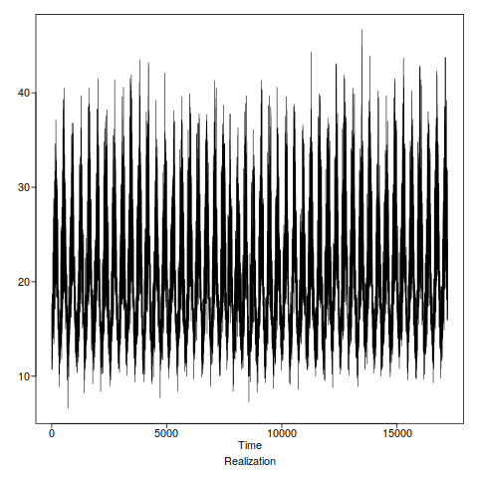
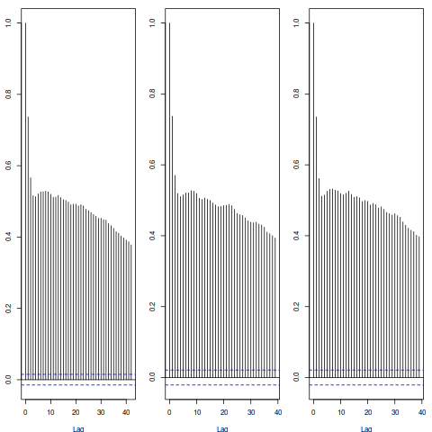
Maximum temperatures in Melbourne, Australia (Celsius)
Description: This time series data set contains the maximum daily temperature in Melbourne, Australia every day since january 1 1971. It is the highest temperature for the 24 hours prior to the observation, which was recorded at 9 am local time. It is publicly available here: http://www.bom.gov.au/jsp/ncc/cdio/weatherData/av?p_nccObsCode=122&p_display_type=dailyDataFile&p_startYear=&p_c=&p_stn_num=086077
Complete
First Half
Second Half

Slide 13
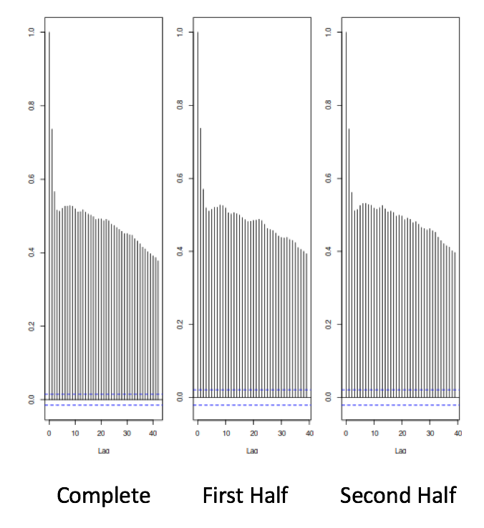
Maximum temperatures in Melbourne, Australia (Celsius)
Description: This time series data set contains the maximum daily temperature in Melbourne, Australia every day since january 1 1971. It is the highest temperature for the 24 hours prior to the observation, which was recorded at 9 am local time. It is publicly available here: http://www.bom.gov.au/jsp/ncc/cdio/weatherData/av?p_nccObsCode=122&p_display_type=dailyDataFile&p_startYear=&p_c=&p_stn_num=086077
Condition 1: Given that these are temperatures, the mean is likely dependent on the time.
Condition 2: It is tough to see any evidence that the variance depends on time and it is reasonable that the temperatures fluctuate around a mean temperature similarly time period by time period (even If they are fluctuating around a time dependent mean.
Condition 3: Given the ACFs, there is little evidence that the covariance depends on where the series is in time.
Realization: This is one in which there is only one realization possible. One could imagine looking at the same stretch of time in a different time period (ie Jan 1 1920 to May 6 1968) although you would have to assume the same conditions were present which is a very big assumption and is most likely a poor one.

Slide 14
Stop Break Out 1

Slide 15
Break Out 2
Run through the following code from the asynch on the next slide and make sure everyone in your understands the code and the output (the confidence interval) and how to interpret it.
If you have time afterwards, got to the slide after that and discuss the difference between the two calculations of gamma_k (the autocovariance at lag k).
Finally, go to the final slide with the plot and discuss the behavior of the two estimators and which one is preferred.

Slide 16
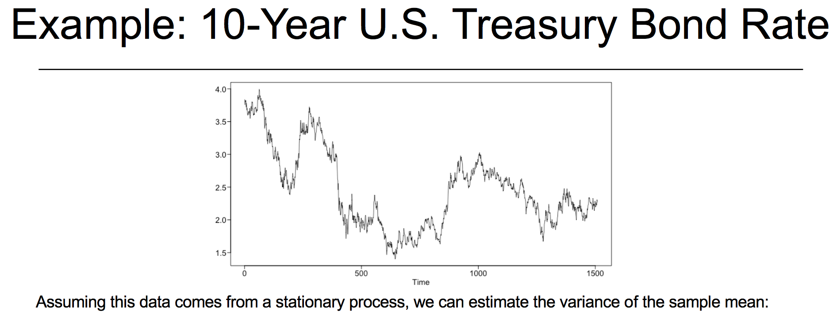
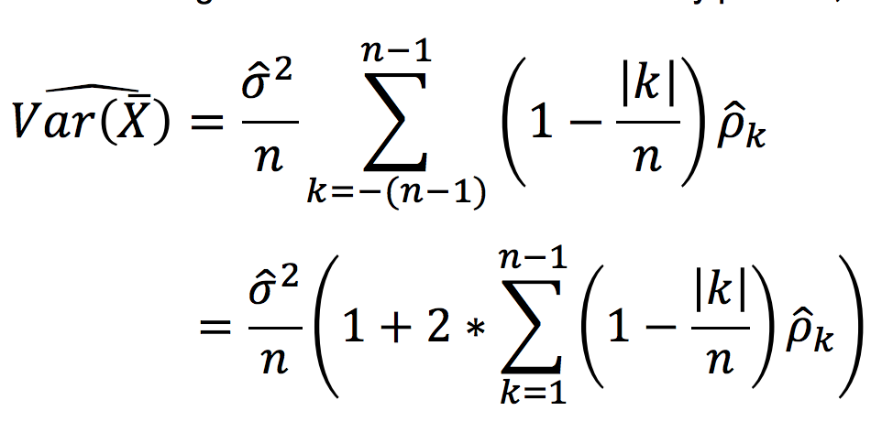
Variance Code
xdf = read.csv(file.choose(),header = TRUE)
x = as.numeric(paste(xdf$Adj.Close))
x = x[!is.na(x)]
n=length(x) #n = 2014
nlag=2013 #n-1
gamma0=var(x)*(n-1)/n
aut=acf(x,lag.max=nlag) #n-1
sum=0
for (k in 1:nlag) {sum=sum+(1-k/n)*aut$acf[k+1]*gamma0}
vxbar=2*sum/n+gamma0/n #note the mult of sum by 2
vxbar

Slide 17
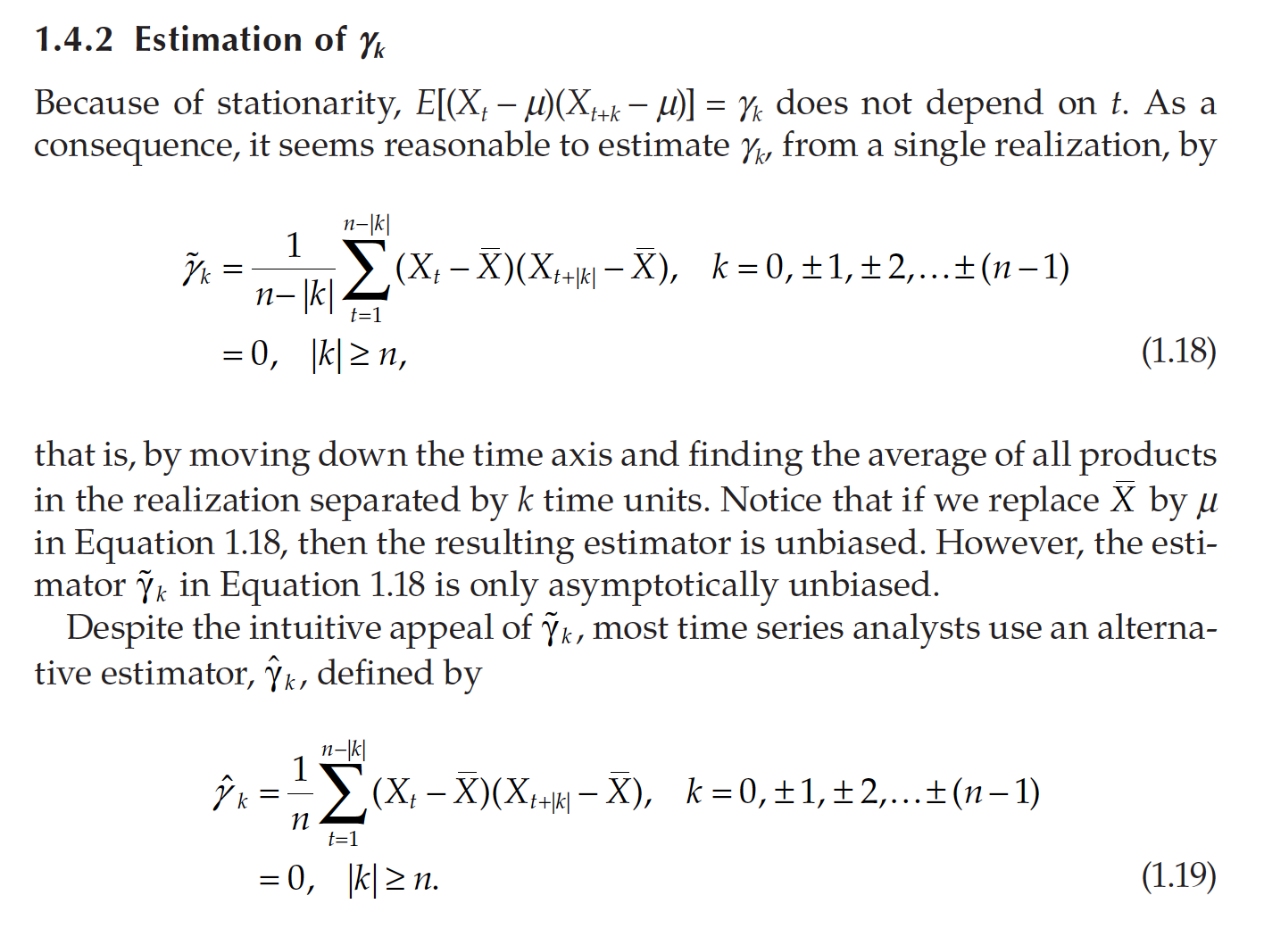
Estimation

Slide 18
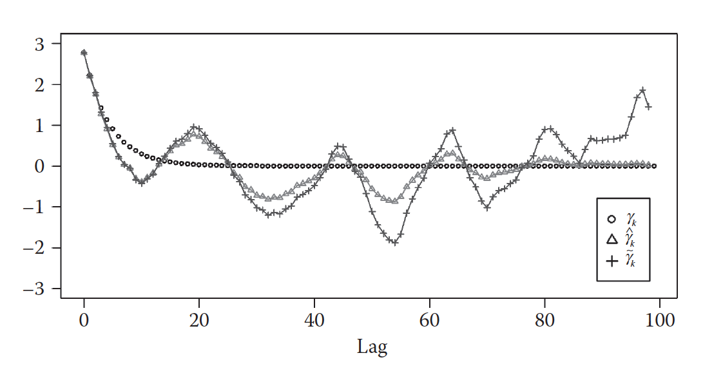
Estimation of Autocovariance

Slide 19
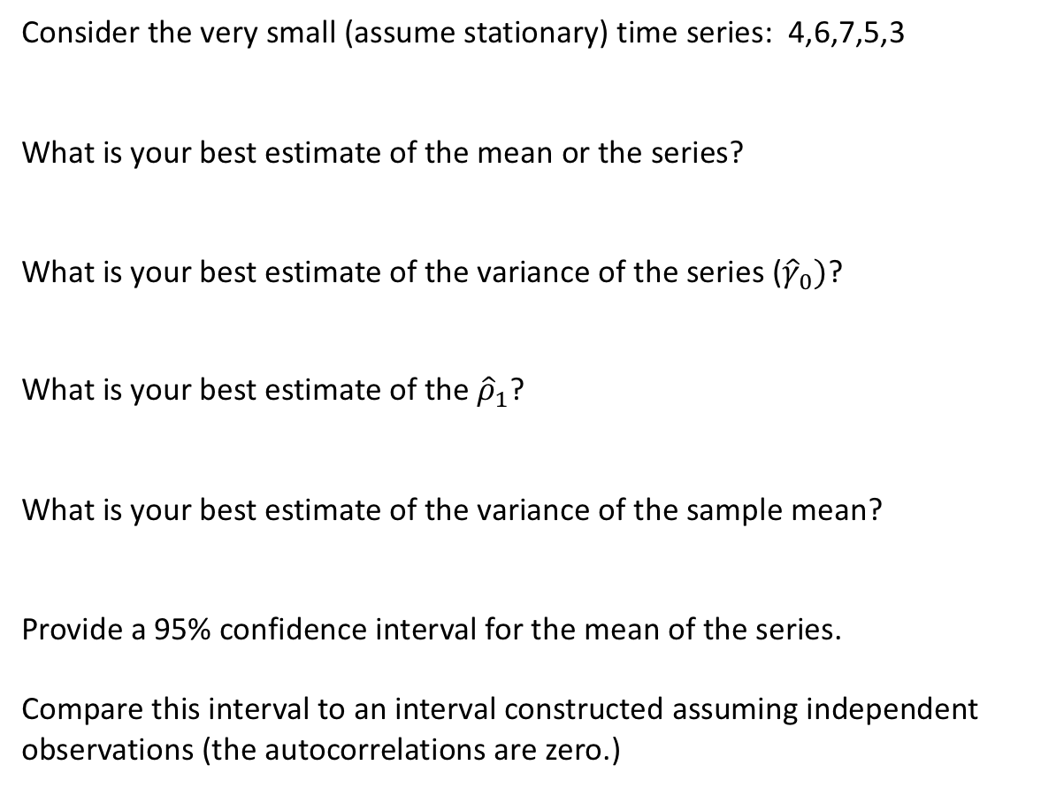
Stop Break Out 2
Consider the very small (assume stationary) time series: 4,6,7,5,3
What is your best estimate of the mean or the series?
What is your best estimate of the variance of the series (${\hat{γ}}_{0})$?
What is your best estimate of the ${\hat{ρ}}_{1}$?
What is your best estimate of the variance of the sample mean?
Provide a 95% confidence interval for the mean of the series.
Compare this interval to an interval constructed assuming independent observations (the autocorrelations are zero.)

Slide 20
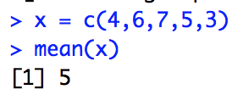
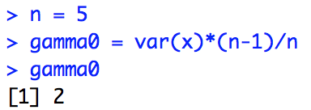
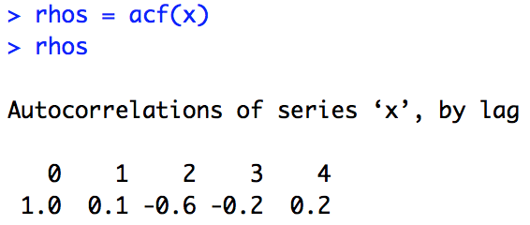
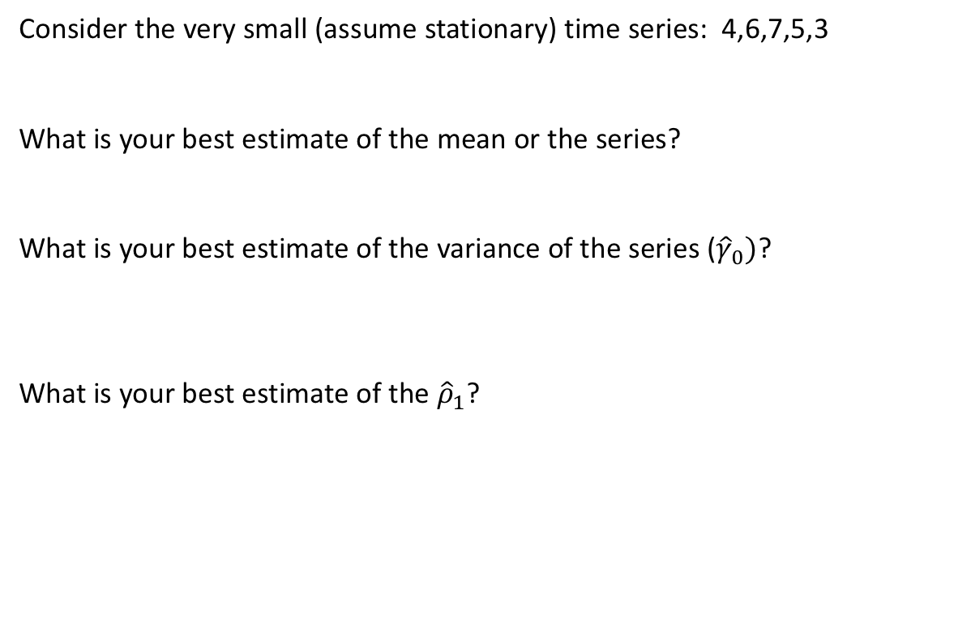
Stop Break Out 2
Consider the very small (assume stationary) time series: 4,6,7,5,3
What is your best estimate of the mean or the series?
What is your best estimate of the variance of the series (${\hat{γ}}_{0})$?
What is your best estimate of the ${\hat{ρ}}_{1}$?

Slide 21
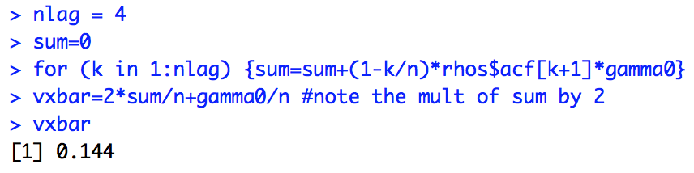
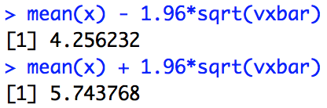
Stop Break Out 2
Consider the very small (assume stationary) time series: 4,6,7,5,3
What is your best estimate of the variance of the sample mean?
Provide a 95% confidence interval for the mean of the series.

Slide 22
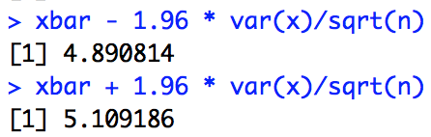
Stop Break Out 2
Consider the very small (assume stationary) time series: 4,6,7,5,3
Provide a 95% confidence interval for the mean of the series.
Compare this interval to an interval constructed assuming independent observations (the autocorrelations are zero.)
Note how much narrower the interval is when we are able to assume independence. We are getting more information about the mean per observation.

